Slide 1
Human Regulation
Nervous and Endocrine Systems

Slide 2
Regulation
To control and coordinate the internal environment with the changing external environment.
Communication within in the body
Homeostasis = to maintain a stable internal environment

Slide 3
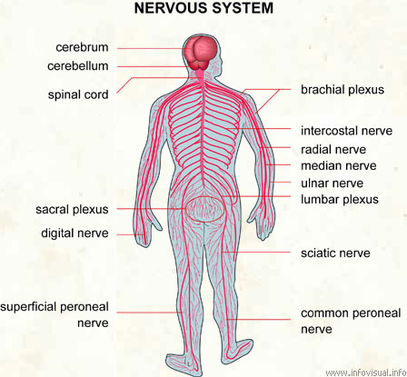

Slide 4
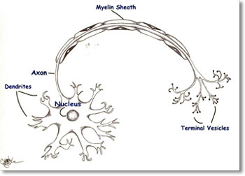
Impulses are the chemical messages of the nervous system

Slide 5
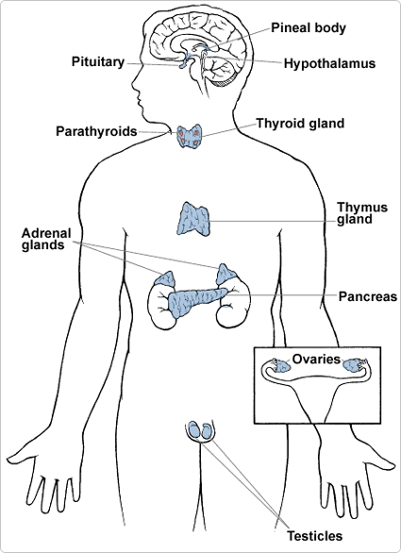

Slide 6
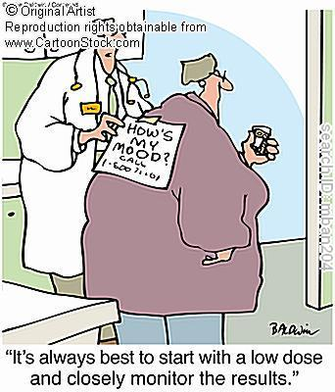
Hormones are the chemical messengers of the endocrine system

Slide 7
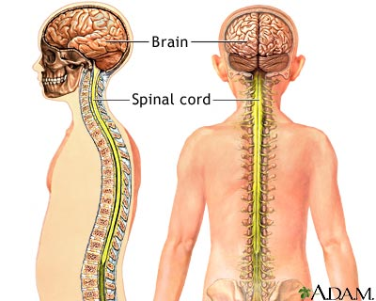
Central Nervous System
Consists of the brain and spinal cord

Slide 8
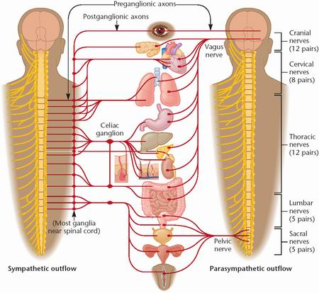
Peripheral Nervous System
Nerves extending from the brain and spinal cord

Slide 9
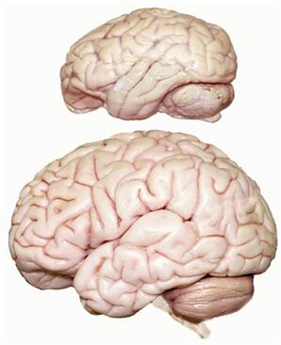
The Brain
Cerebrum deals with thinking, problem solving, personality.
Cerebellum deals with balance and coordination
Medulla deals with involuntary activities (breathing)

Slide 10
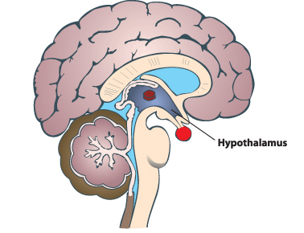
Hypothalamus
The hypothalamus regulates homeostasis. It has regulatory areas for thirst, hunger, body temperature, water balance, and blood pressure, and links the nervous system to the endocrine system.

Slide 11
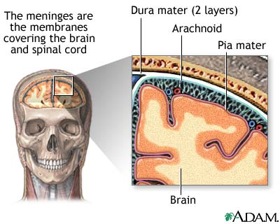
Meninges
Membrane that surrounds the brain and spinal cord

Slide 12
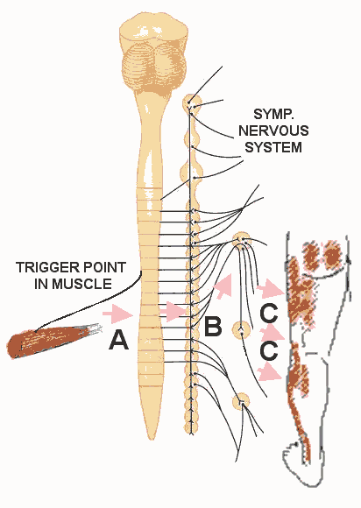
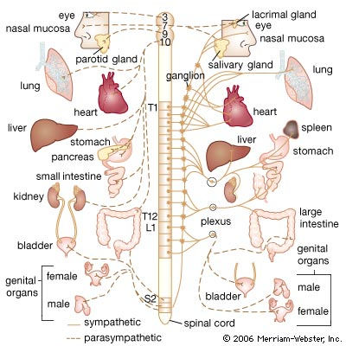
Peripheral Nervous Subdivisions
Somatic N.S.
voluntary
Autonomic N.S.
involuntary

Slide 13
Autonomic Nervous System Sub-divisions
Sympathetic
Periods of stress
Neurotransmitter=
noradrenalin
Speeds up heart rate
Slows down digestion
Parasympathetic
Periods of calm
Neurotransmitter=
acetylcholine
Inhibits heart rate
Stimulates digestion

Slide 14
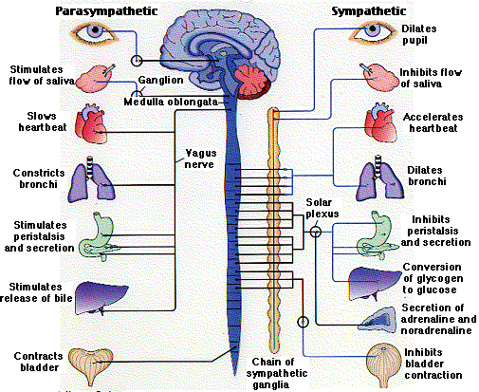

Slide 15
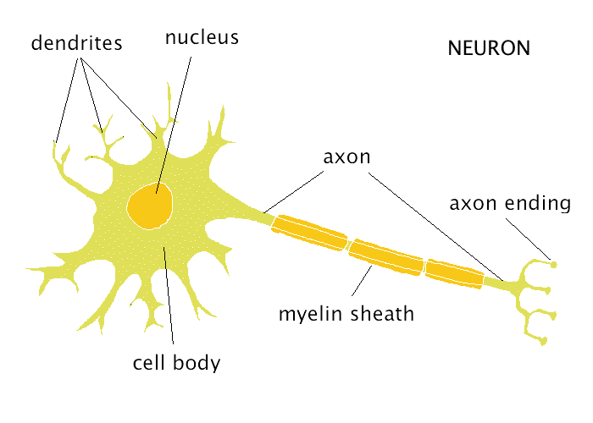
Neuron
Dendrite = receives the message/impulse
Terminal (axon) branch = send the message/impulse by secreting neurotransmitters
Neurotransmitters=chemicals that carry the impulse across the synapse
Synapse=gap between neurons
Receptor molecules are specific shape structure that will receive the message

Slide 16
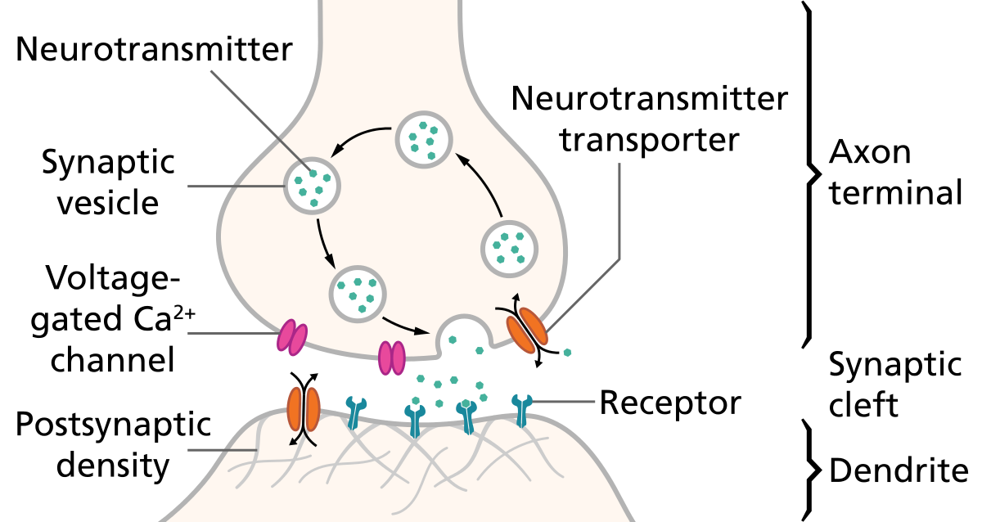
Receptor Molecule Diagram at Synapse

Slide 17
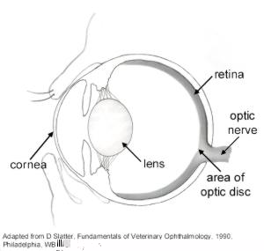
Sight
Optic Nerve

Slide 18
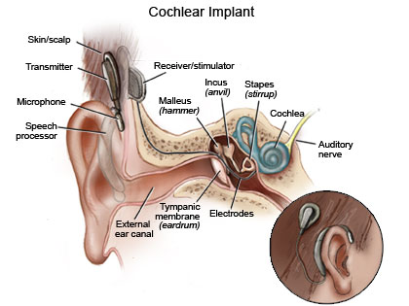
Hearing
Auditory Nerve

Slide 19
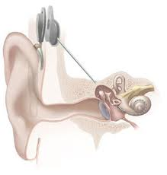
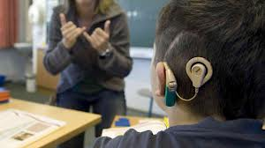
Cochlear Implant
http://www.youtube.com/watch?v=HTzTt1VnHRM

Slide 20
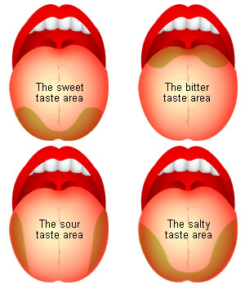
Taste
Taste buds

Slide 21
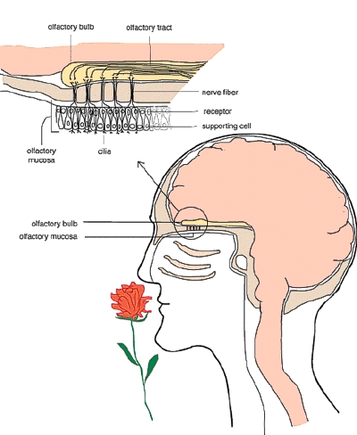
Smell
Olfactory nerve

Slide 22
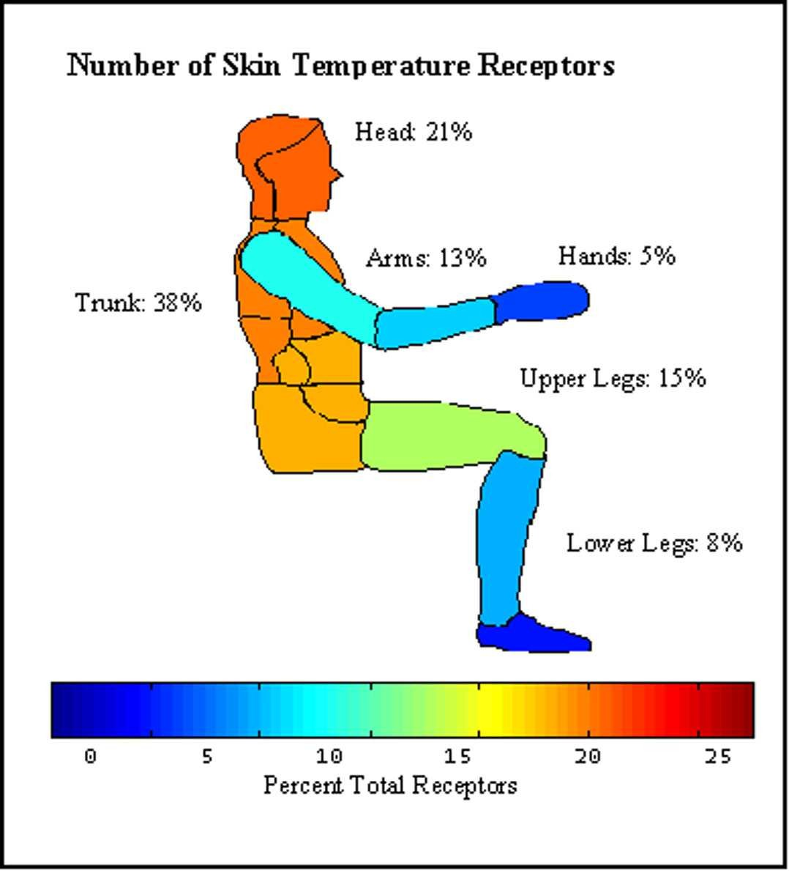
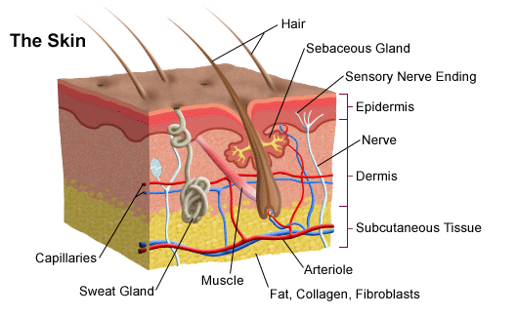
Touch
Receptors in skin

Slide 23
Reflex arc
Stinky Running Shoes In My Empty Room.
Stimulus
Receptor
Sensory neuron
Interneuron
Motor neuron
Effectors
Response

Slide 24
Malfunctions of the Human Nervous System
Cerebral palsy
Meningitis
Stroke
Polio
Parkinson’s disease
Alzheimer's Disease
Amyotrophic Lateral Sclerosis
Bell's Palsy
Brain Cancers
Brain Tumors
Epilepsy
Multiple Sclerosis...
Muscular Dystrophy...

Slide 25
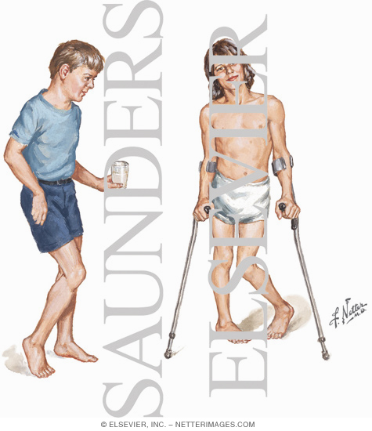
Cerebral Palsy
permanently affect body movement and muscle coordination
caused by abnormalities in parts of the brain that control muscle movements.

Slide 26
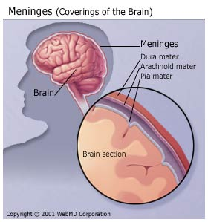
Meningitis
Inflammation of the meninges
potentially fatal bacterial/viral infection

Slide 27
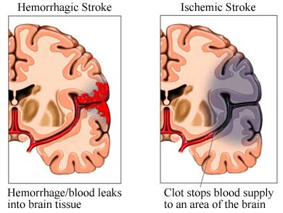
Stroke
A stroke is loss of brain functions due to a disturbance in the blood vessels supplying blood to the brain.

Slide 28
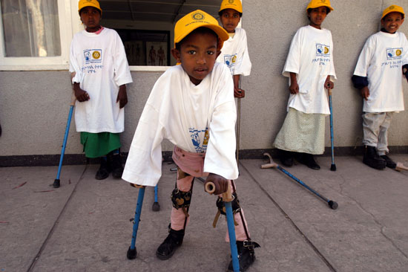
Polio
Polio (also called poliomyelitis) is a contagious disease cause by a virus which affect nerves that can cause partial/full paralysis
Vaccination, created by Jonas Salk, became widely available in 1955.

Slide 29
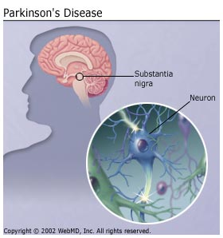

Parkinson’s Disease
Parkinson's disease results from gradual degeneration of nerve cells in the portion of the midbrain that controls body movements.

